Slide 1
Name: _______________________ Date:___________________
are
Ants
have
can
___________________________Word Bank__________________________________
insects.
6 legs.
lay eggs.

Slide 2
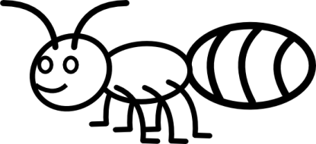
are | Ants | insects.
are | Ants | insects.
are | Ants | insects.
are | Ants | insects.

Slide 3
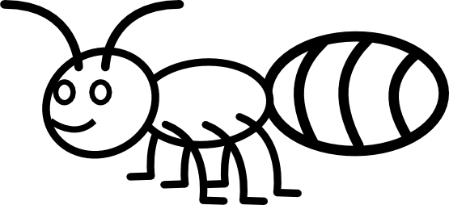
Name: _______________________________________ Date: _________________
Main Idea:
Details:

