Slide 1
Name: _______________________ Date:___________________
are
Foxes
have
can
___________________________Word Bank__________________________________
nocturnal.
bushy tails.
dig.

Slide 2
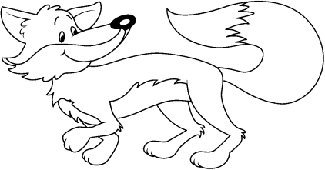
is | This | fox. | a
is | This | fox. | a
is | This | fox. | a
is | This | fox. | a

Slide 3
Name: _______________________________________ Date: _________________
Main Idea:
Details:

