Slide 1
Name: _______________________ Date:___________________
are
Owls
have
can
___________________________Word Bank__________________________________
birds.
feathers.
lay eggs.

Slide 2
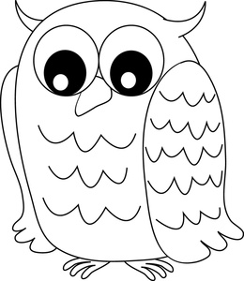
are | Owls | birds.
are | Owls | birds.
are | Owls | birds.
are | Owls | birds.

Slide 3
Name: _______________________________________ Date: _________________
Main Idea:
Details:

